Slide 1

HR Analytics – Attrition Analysis
A project by Debasmita Paul

Slide 2
Objectives
The HR analytics aims to provide a comprehensive overview of employee attrition within the organization. The objective is to identify the key factors contributing to employee turnover and analyze trends across demographics, education levels, job roles, and salary bands. By uncovering these insights, we can recommend targeted strategies to improve employee retention, enhance job satisfaction, and support workforce planning decisions.

Slide 3
Research Questions
How does employee attrition vary across different education backgrounds?
Which age groups are experiencing the highest attrition?
How does salary impact employee attrition?
Is there a pattern in attrition based on the years employees spend at the company?
Which job roles have the highest number of attritions?

Slide 4
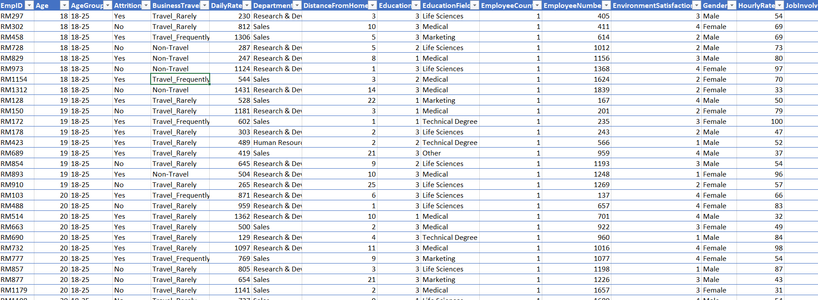
Data Snapshot

Slide 5
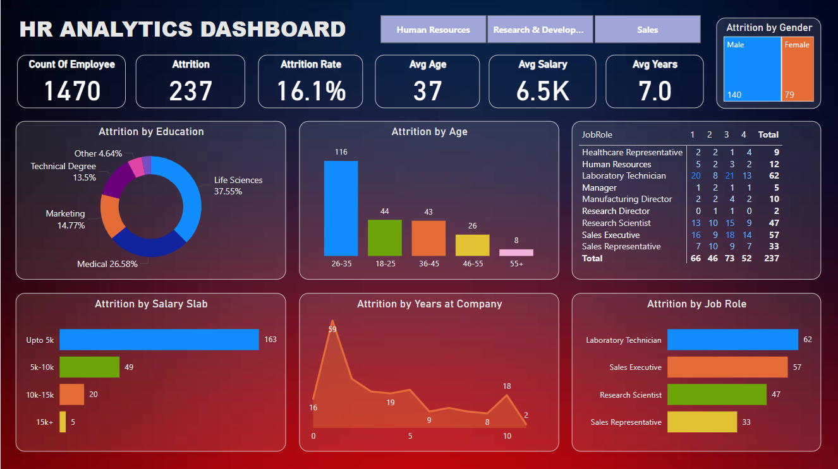
HR Analytics Dashboard Overview
This interactive HR Analytics dashboard provides a comprehensive overview of employee attrition within the organization. It highlights key metrics such as total employees, total attrition count, attrition rate, average age, average salary, and average tenure in years. The dashboard allows filtering by department, gender, and other dimensions to facilitate deeper analysis.

Slide 6
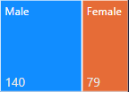
Attrition by Gender
The tree map shows that male employees have a higher proportion of attrition compared to female employees. The larger section represents 140 male employees who have left, while the smaller section represents 79 female employees. This visualization highlights the gender distribution of attrition within the organization.

Slide 7
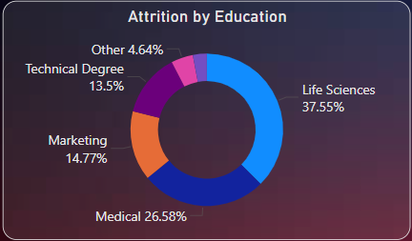
Attrition by Education Field
This pie chart illustrates attrition distribution based on employees' educational backgrounds. The highest percentage of attrition comes from employees with a Life Sciences background, accounting for 37.55% of total attrition. Medical graduates represent the second-highest group at 26.58%, followed by Marketing at 14.77%, Technical Degree holders at 13.5%, and Other educational backgrounds at 4.64%. This suggests that Life Sciences and Medical professionals may be experiencing challenges that influence their decision to leave the organization.

Slide 8
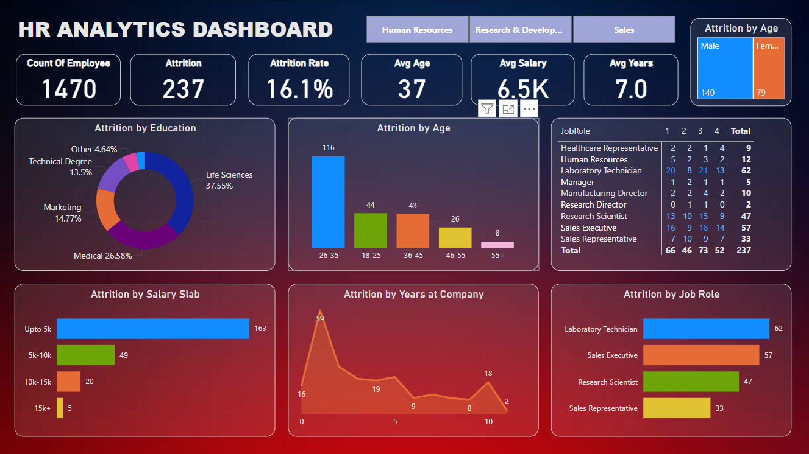
Attrition by Age Group
This bar chart shows attrition numbers by different age groups. The highest attrition is observed in the 26-35 age group, with 116 employees leaving the company. This is followed by the 18-25 group with 44 cases and the 36-45 group with 43 cases. The trend highlights that younger and mid-career professionals are more prone to attrition, likely due to career advancement aspirations or better salary opportunities elsewhere.

Slide 9
Attrition by Salary Slab
This horizontal bar chart displays attrition categorized by salary slabs. The majority of attrition, 163 employees, falls into the lowest salary slab of up to 5K. Attrition decreases in the higher salary brackets, with 49 cases in the 5K-10K range, 20 in the 10K-15K range, and only 5 in the 15K+ slab. The data suggests a strong correlation between lower salary levels and higher attrition rates, indicating compensation could be a key factor.

Slide 10
Attrition by Years at Company
This line chart presents the trend of attrition based on employees' years of service at the company. The highest attrition occurs during the first year of employment, with 59 employees leaving. After the initial year, attrition gradually declines, with occasional spikes around 10 years of service. This suggests employees are most vulnerable to leaving during their early tenure, potentially due to unmet job expectations or onboarding challenges.

Slide 11
Attrition by Job Role
This bar chart highlights attrition numbers by job role. The highest attrition is observed in the Laboratory Technician role, with 62 employees leaving. Sales Executives follow with 57 cases, and Research Scientists with 47. Sales Representatives also show notable attrition at 33 cases. This suggests specific job roles face higher turnover, potentially due to job demands, compensation, or lack of growth opportunities.

Slide 12
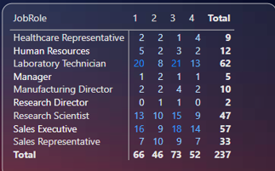
Attrition by Job Role and Experience
This matrix table shows attrition counts for each job role broken down by experience levels (years). For example, Laboratory Technicians experience the most attrition in the 1-year category, with 20 employees leaving. This detailed breakdown provides an understanding of how attrition varies not just by role but also by experience level.

Slide 13
Insights
Based on the dashboard analysis, the following insights were observed:
The overall attrition rate is 16.1%, with a total of 237 employees leaving the organization.
Life Sciences and Medical graduates account for the majority of attrition, with Life Sciences making up 37.55% of total attrition.
The 26-35 age group has the highest attrition, contributing to 116 out of 237 cases.
A significant portion of attrition is concentrated in the lower salary slabs, especially employees earning up to 5K, which accounts for 163 employees.
Employees tend to leave most frequently in the first year, with a peak attrition at 1 year of service (59 employees).
The Laboratory Technician role shows the highest attrition, followed by Sales Executive and Research Scientist roles.

Slide 14
Conclusion
The analysis reveals that attrition is more prevalent among mid-career employees aged 26-35, particularly in roles such as Laboratory Technician and Sales Executive, and is higher among those with lower salary slabs and shorter tenures at the company. Education background also plays a role, with employees from Life Sciences and Medical fields leaving more frequently. These patterns suggest that compensation, career growth opportunities, and employee engagement are critical factors influencing attrition.

Slide 15
Recommendations
Based on the findings, the following recommendations are proposed to reduce attrition and improve employee retention:
Focus on increasing salaries in the lower bands to improve job satisfaction and reduce turnover, especially for employees earning up to 5K.
Pay special attention to high-attrition job roles like Laboratory Technicians and Sales Executives, offering tailored career growth opportunities and engagement programs.
Introduce initiatives aimed at employees in the 26-35 age bracket, as they represent the highest attrition group.
Design onboarding programs and career development paths that encourage employees to stay beyond the first year, when attrition is at its peak.
Explore factors leading to higher attrition in these education groups and design professional growth opportunities tailored to their skill sets.

Slide 16
THANK YOU

